Slide 1
Introduction
Spatial Epidemiology in R
PH272C – Week 1
Fall 2018

Slide 2
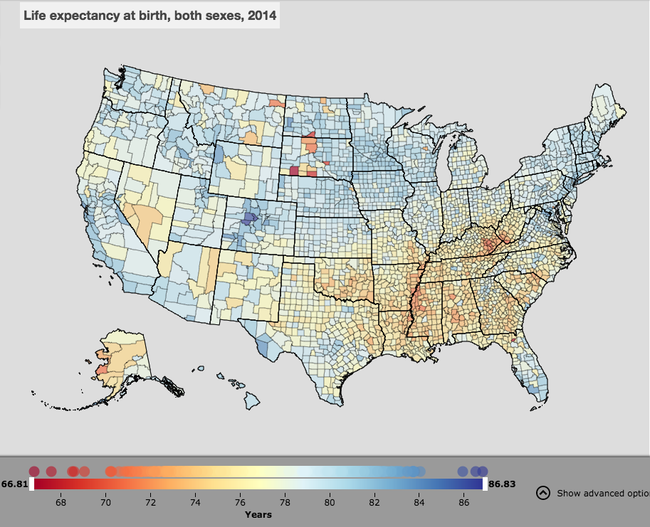

Slide 3
Course Objectives
Review types of data you may handle
Explore tools/software to visualize, explore and analyze spatial data
Learn techniques available for visualising, exploring and analyzing data
Learn to love R!

Slide 4



The Team
Hugh Sturrock
Alemayehu Midekisa
Ricardo Andrade-Pacheco
Everleigh Stokes

Slide 5
Overview
Session | Week start
Concepts of spatial epidemiology | October 22nd
Hugh Sturrock

Slide 6
Overview
Session | Week start
Concepts of spatial epidemiology | October 22nd
Manipulating and relating spatial data | October 29th
Hugh Sturrock

Slide 7
Overview
Session | Week start
Concepts of spatial epidemiology | October 22nd
Manipulating and relating spatial data | October 29th
Spatial variation in risk | November 5th
Hugh Sturrock

Slide 8
Overview
Session | Week start
Concepts of spatial epidemiology | October 22nd
Manipulating and relating spatial data | October 29th
Spatial variation in risk | November 5th
Cluster analysis | November 12th
Hugh Sturrock

Slide 9
Overview
Session | Week start
Concepts of spatial epidemiology | October 22nd
Manipulating and relating spatial data | October 29th
Spatial variation in risk | November 5th
Cluster analysis | November 12th
Working with remote sensing data | November 19th
Alemayehu Midekisa

Slide 10
Overview
Session | Week start
Concepts of spatial epidemiology | October 22nd
Manipulating and relating spatial data | October 29th
Spatial variation in risk | November 5th
Cluster analysis | November 12th
Working with remote sensing data | November 19th
Intro to spatial regression analysis | November 26th
Ricardo Andrade

Slide 11
Overview
Session | Week start
Concepts of spatial epidemiology | October 22nd
Manipulating and relating spatial data | October 29th
Spatial variation in risk | November 5th
Cluster analysis | November 12th
Working with remote sensing data | November 19th
Intro to spatial regression analysis | November 26th
Spatial regression analysis | December 3rd
Ricardo Andrade

Slide 12
Overview
Session | Week start
Concepts of spatial epidemiology | October 22nd
Manipulating and relating spatial data | October 29th
Spatial variation in risk | November 5th
Cluster analysis | November 12th
Working with remote sensing data | November 19th
Intro to spatial regression analysis | November 26th
Spatial regression analysis | December 3rd
Final assessment | December 10th

Slide 13
Grades
Labs (0%)
Each week we will post a lab for you to work through on your own time
The lab will be the exact same as the code demonstrated via video, with a few addition tasks
Labs are for practice, they are NOT graded
Assignments (20%)
Each week we will post an R assignment to be completed and turned in via bCourses
Final (80%)
This will be a written piece, should be journal article-esque
Include spatial analysis on your own dataset incorporating topics covered across the 8 weeks

Slide 14
Visualizing Spatial Data
Spatial Epidemiology in R
PH272C – Week 1
Fall 2018

Slide 15
Spatial epidemiology
Spatial epidemiology is the description and analysis of geographic variations in disease with respect to demographic, environmental, behavioral, socioeconomic, genetic, and infectious risk factors.

Slide 16
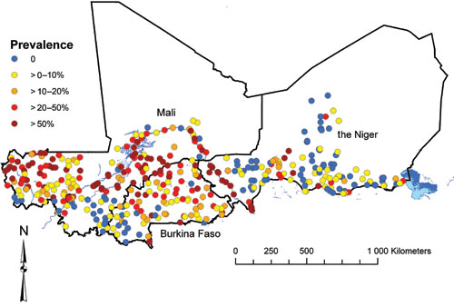
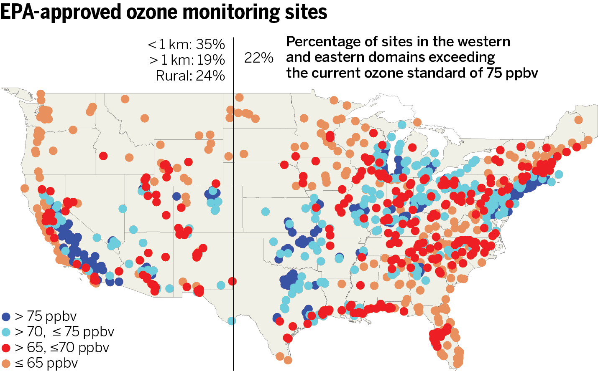
Spatial Data Types
Point level data
Schistosomiasis in Mali
Clements et al (2009) PLoS Negl Trop Dis 3(5): e431

Slide 17
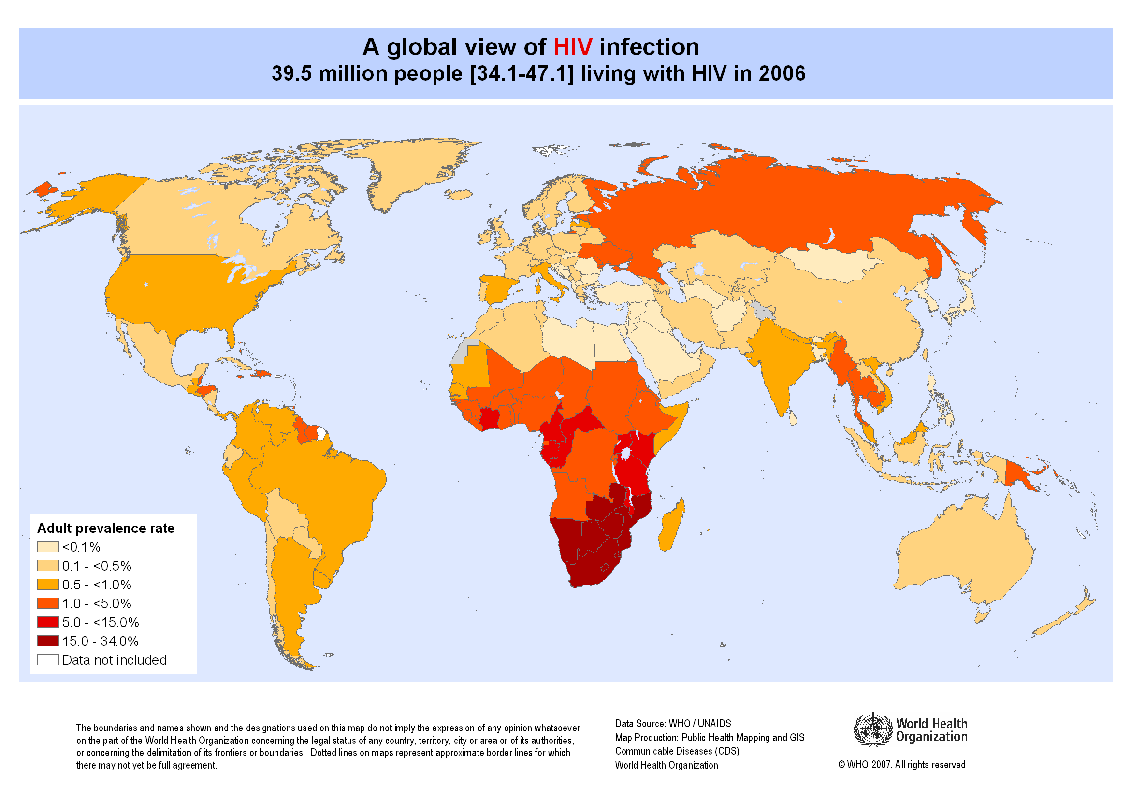
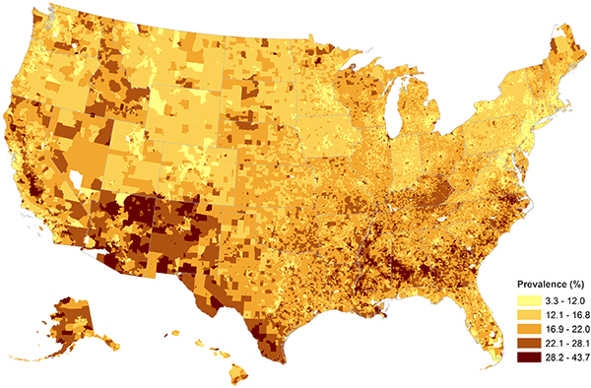
Spatial Data Types
Aggregate data
Childhood Obesity Prevalence at the Census Block-Group Level

Slide 18
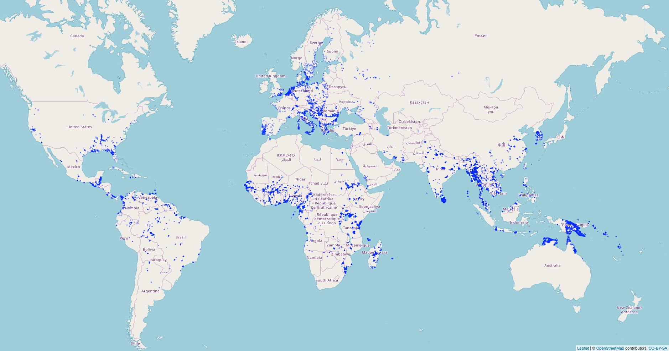
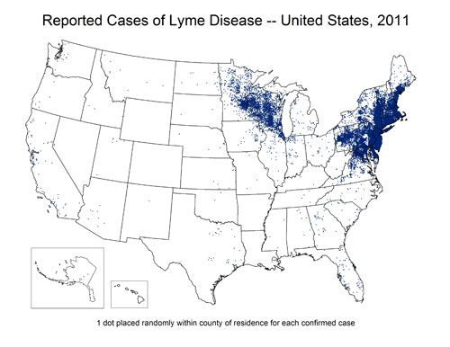
Spatial Data Types
Point process data
Presence of malaria vectors

Slide 19
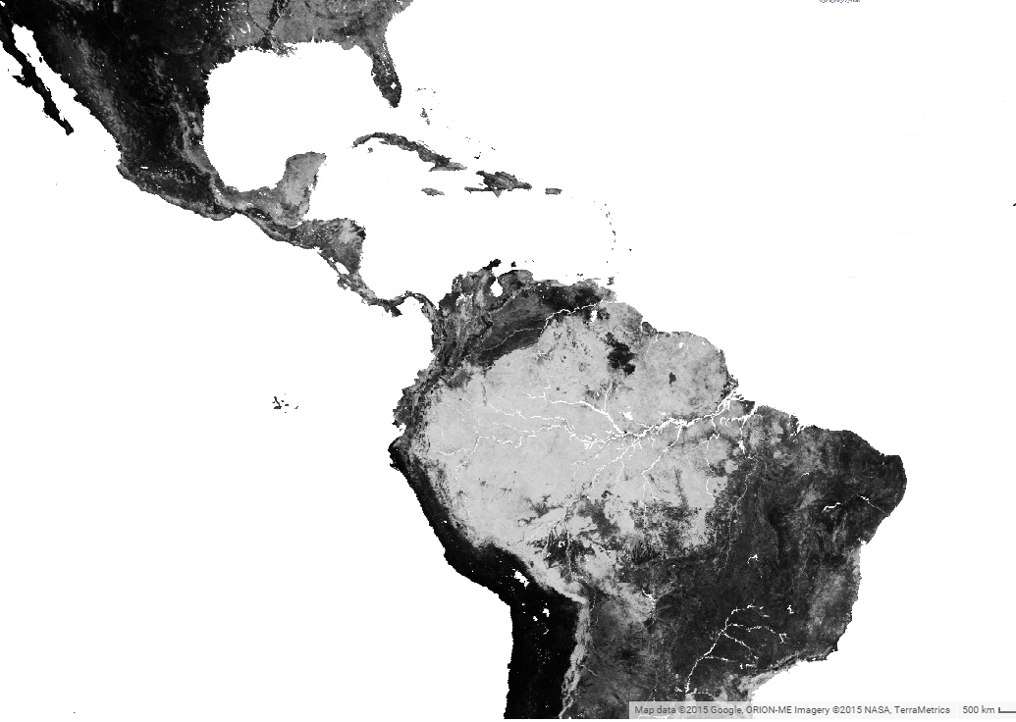
Spatial Data Types
Raster Data
Example: remotely sensed data – provide complete coverage at the spatial resolution of the sensor
Percentage tree cover

Slide 20
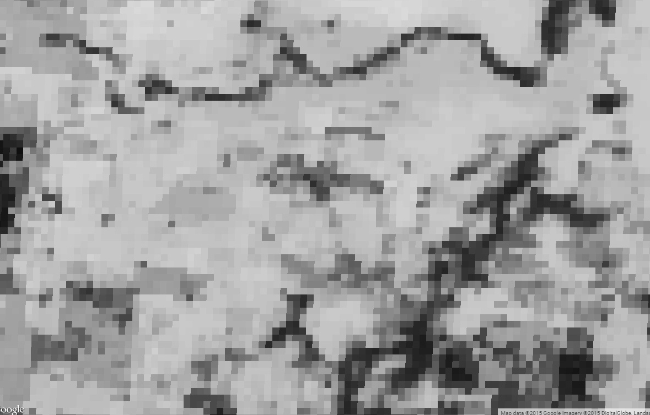
Spatial Data Types
Raster Data
Example: remotely sensed data – provide complete coverage at the spatial resolution of the sensor

Slide 21
Visualization
Exploration
Analysis

Slide 22
Visualization
Exploration
Analysis

Slide 23
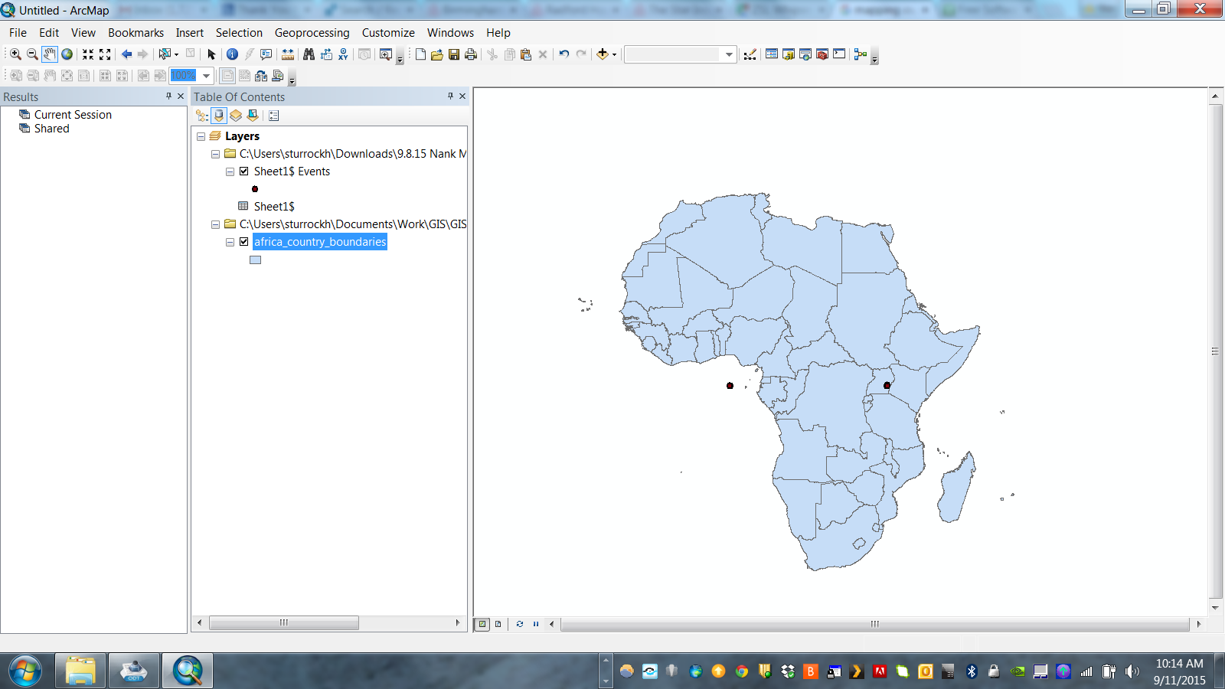
1. Identify Errors/Outliers

Slide 24
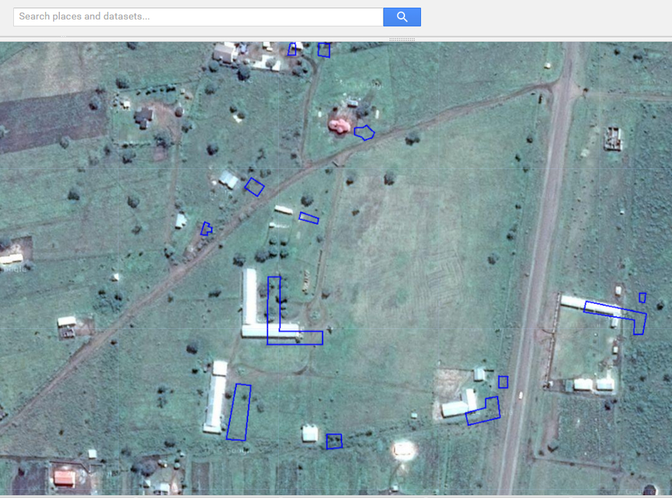
1. Identify Errors/Outliers

Slide 25
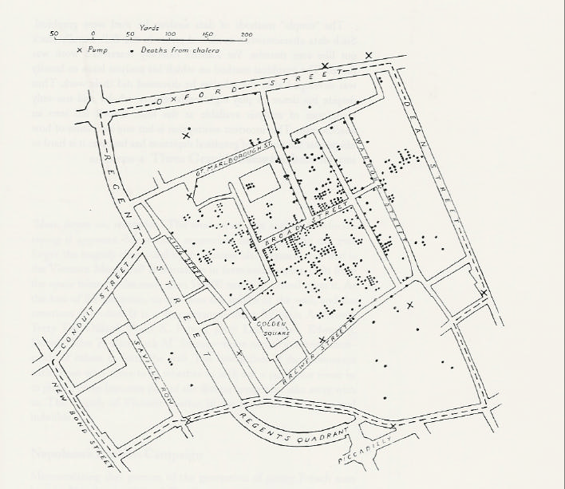
2. Identify Trends

Slide 26
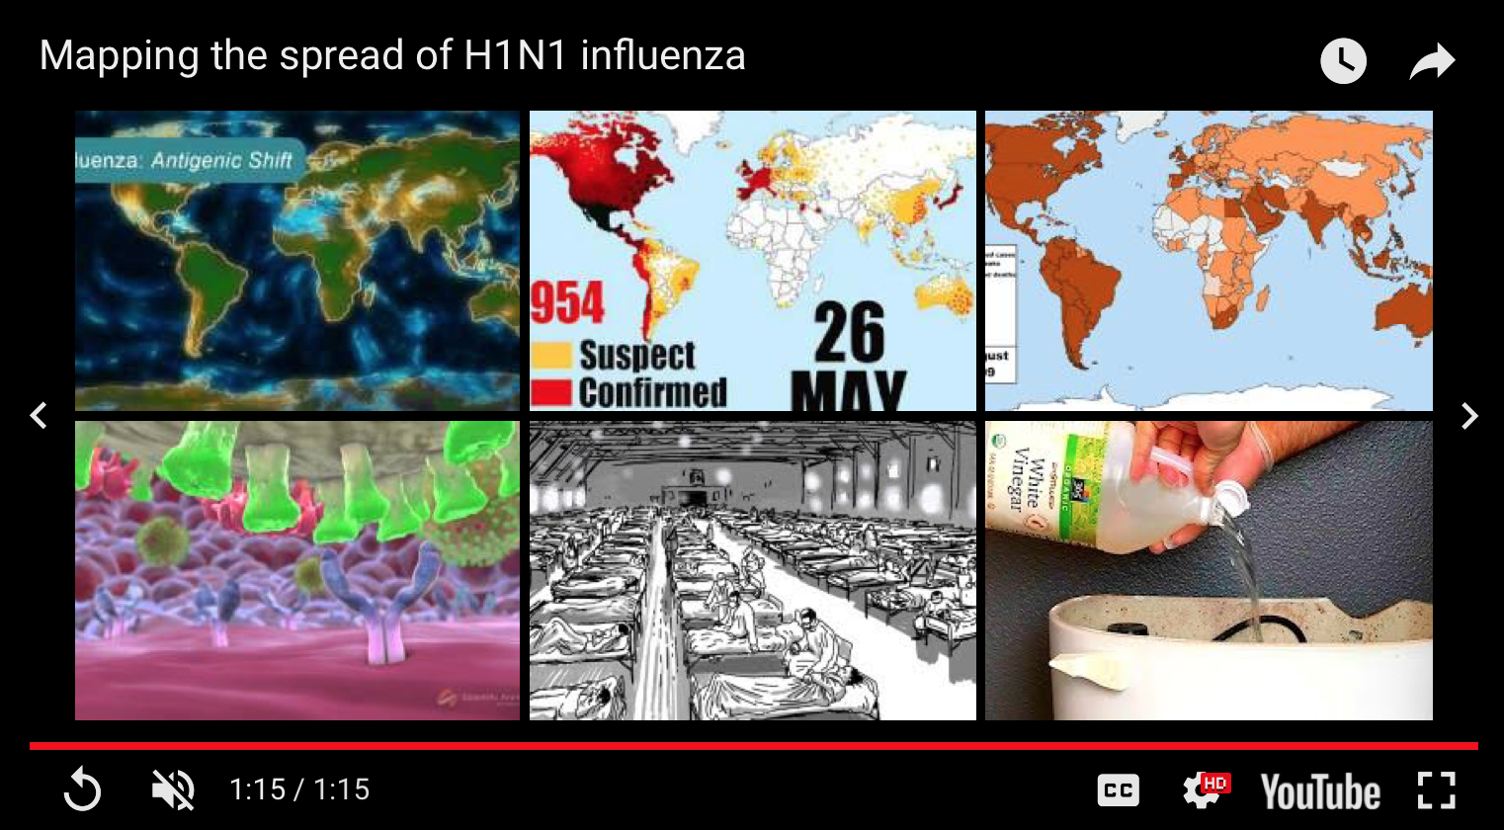
https://www.youtube.com/watch?v=2jOtehF01Kc

Slide 27
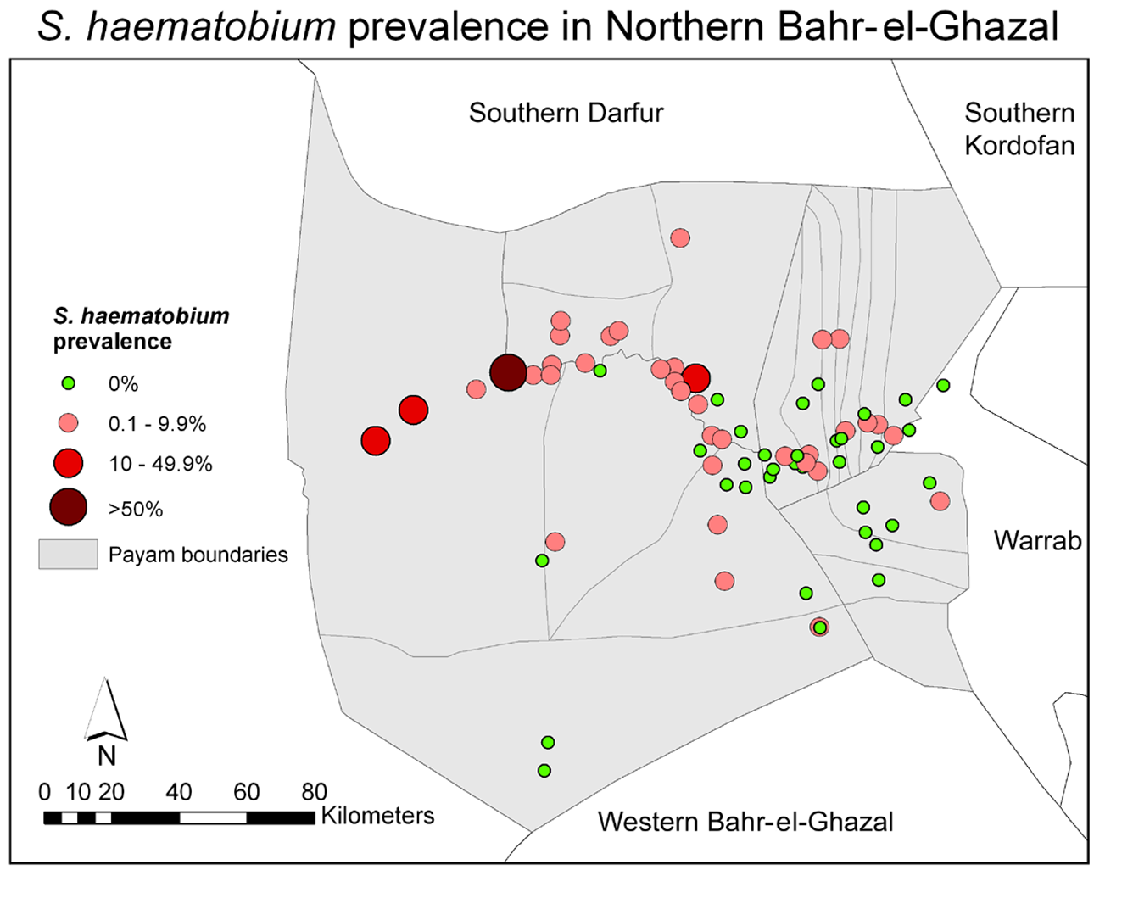
Mapping Point Level Data
Sturrock et al (2010) PLoS Negl Trop Dis 3(10)

Slide 28
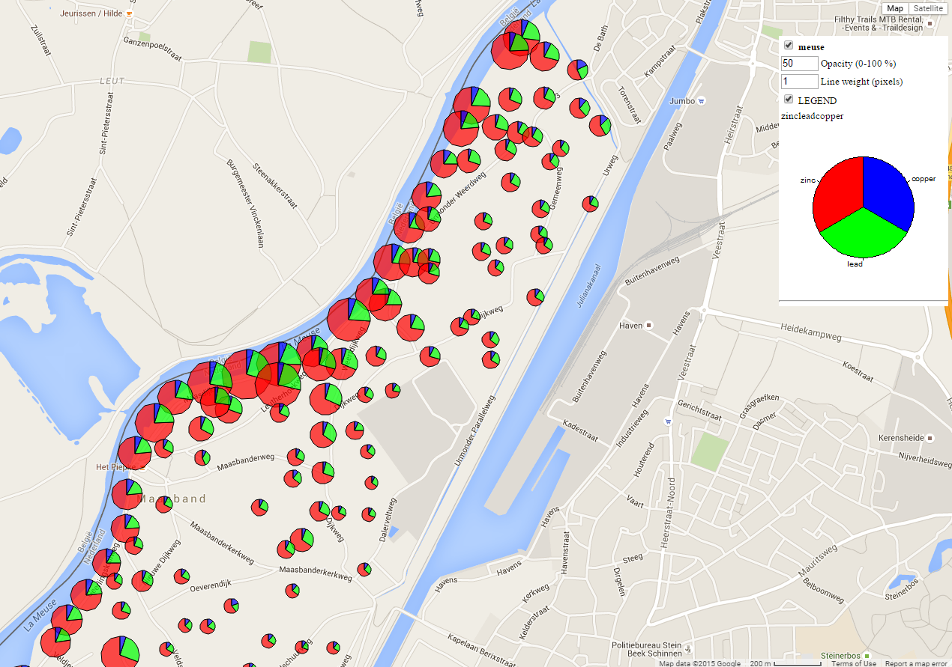
Mapping Point Level Data

Slide 29
Choropleth Maps
Greek: choros (place) + plethos (filled)
These use polygonal enumeration units
e.g. census tract, counties, watersheds, etc. to visualize aggregated data
Data values are generally classified into ranges

Slide 30
Unemployment Rates 2016

Slide 32
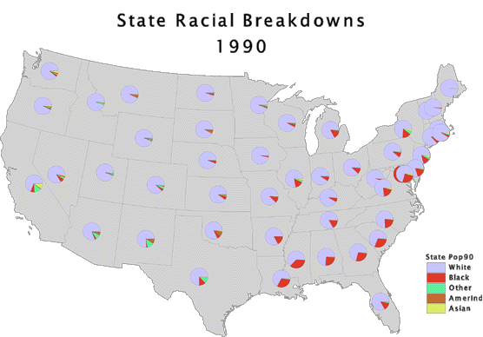
Mapping Multivariate Data

Slide 33
Disadvantages
Assumes mapped data are uniformly distributed in each unit – not usually true!

Slide 34
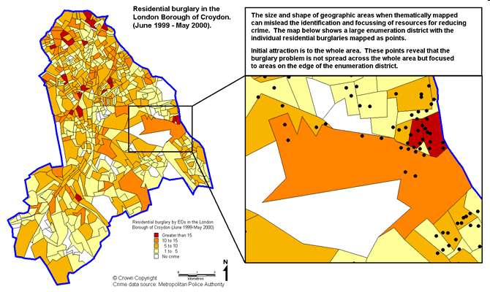
http://www.crimereduction.homeoffice.gov.uk/toolkits/fa020204-map1.htm
Notes:
The map below shows robbery data thematically shaded by enumeration districts across the London Borough of Croydon. A custom range has been used to present the distribution of this crime type. The map serves the purpose of identifying those enumeration districts that are grouped in the highest crime count categories. The map also makes use of natural colours that complement the central message of the map (i.e. where are the hotspots?), and a sensible number of ranges to represent the pattern of this crime across Croydon. When identifying hotspots from this map early attention is drawn to the large enumeration districts that are coloured in the darker orange shading, rather than the EDs of the same colouring but less than a tenth the size. This type of mapping can often mislead identifying and prioritising crime reduction resources to areas that appear as problems, but where the problem is exaggerated from a thematic map of areas of varying size and shapes

Slide 35
Disadvantages
Assumes mapped data are uniformly distributed in each unit – not usually true!
Political boundaries are frequently unrelated to the spatial distribution of the phenomena being mapped

Slide 36
Disadvantages
Assumes mapped data are uniformly distributed in each unit – not usually true!
Political boundaries are frequently unrelated to the spatial distribution of the phenomena being mapped
Large polygons tend to dominate the display

Slide 37
Disadvantages
Assumes mapped data are uniformly distributed in each unit – not usually true!
Political boundaries are frequently unrelated to the spatial distribution of the phenomena being mapped
Large polygons tend to dominate the display
Highly skewed data are difficult to display using a finite number of colour shades

Slide 38
Cartograms
Overcomes problem of physical dominance of large areas
Geometrically transforms the area of each polygon so that it is proportional to the corresponding attribute
Distort area and distance, forsaking spatial detail
See www.worldmapper.org

Slide 39
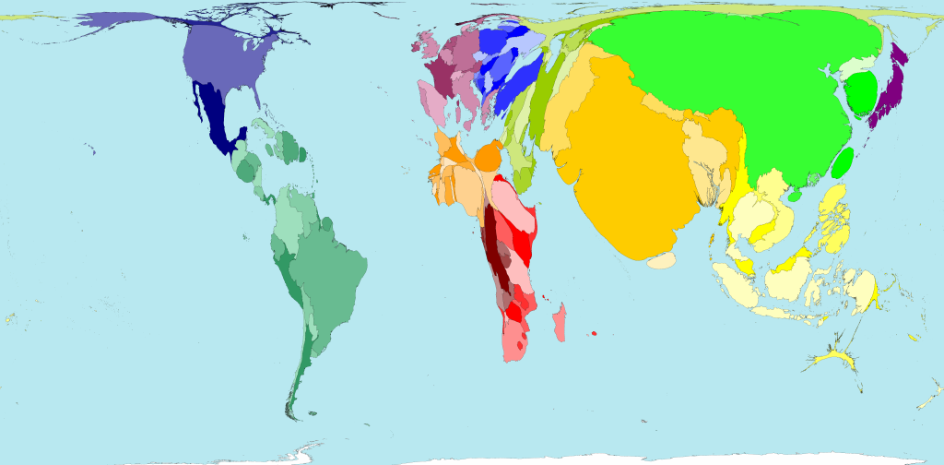
Road traffic accidents
Territory size shows the proportion of all road traffic accident deaths worldwide that occurred there.

Slide 40
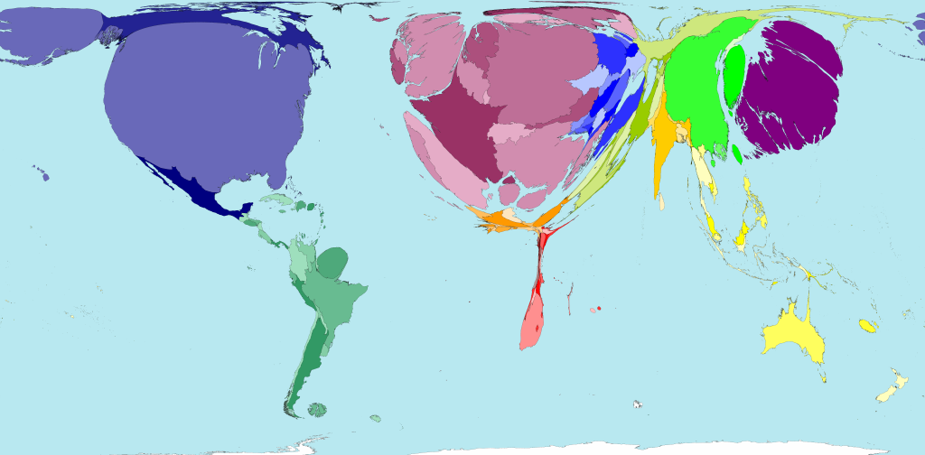
Public health spending
Territory size shows the proportion of worldwide spending on public health services that is spent there. This spending is measured in purchasing power parity.

Slide 41
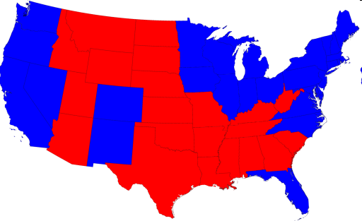
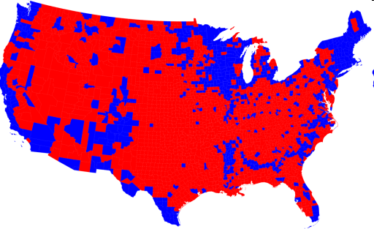
2008 Presidential Elections
Choropleths:
http://www-personal.umich.edu/~mejn/election/2008/

Slide 42
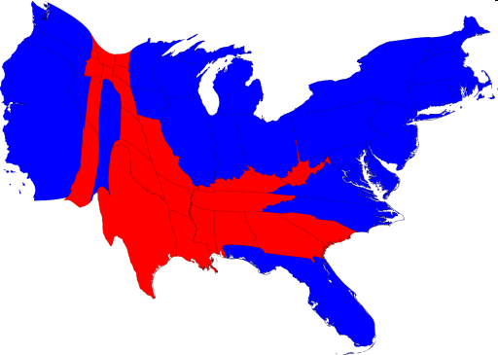
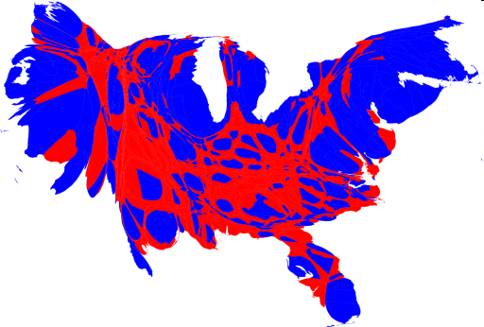
2008 Presidential Elections
Choropleths:
Cartograms:
http://www-personal.umich.edu/~mejn/election/2008/

Slide 43
Modifiable Areal Unit Problem (MAUP)
What is it?
Observed patterns may be as much a function of the chosen zone boundaries as the underlying spatial distribution
Can cause problems later during analysis via:
Scale Effects
- variation in numerical results that occurs due to level of aggregation used in an analysis
(B) Zone Effects
- variation in numerical results that occurs due to regrouping of data into different configurations at the same scale

Slide 44
Modifiable Areal Unit Problem (MAUP)
10
15
5
5
10
15
6.66
11.66
6.66
Scale effect
5
10
5
x=8.88; n=9
x=8.33; n=3
12.5
7.5
11.25
8
Zone effect
6.66
7.5
x=8.47; n=3
x=9.33; n=3

Slide 45
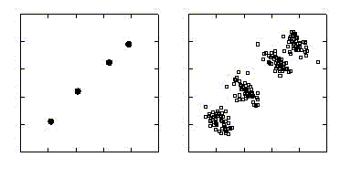
Ecological Bias
Describes the difference between estimated associations based on aggregate- and individual-level data
Country
Individual
Outcome
Exposure

Slide 46
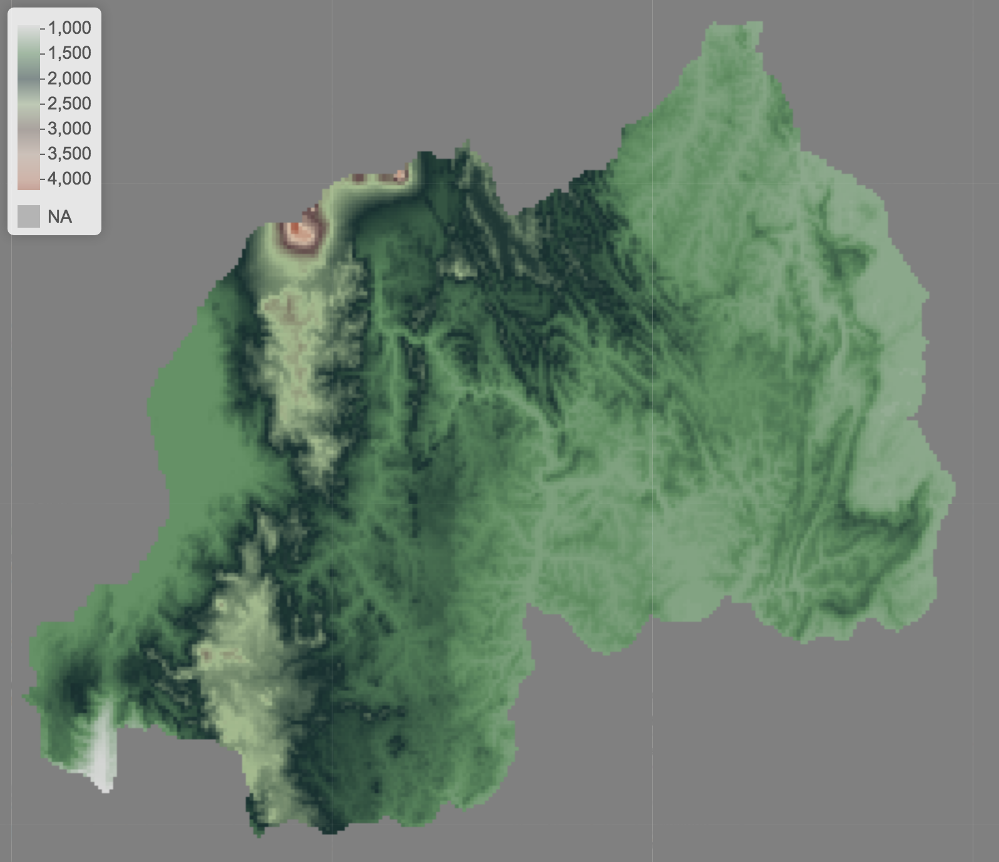
Spatial Data: Raster
For example, remotely sensed data – provide complete coverage at the spatial resolution of the sensor
Elevation in Rwanda

Slide 47
Visualization
Exploration
Analysis

Slide 48
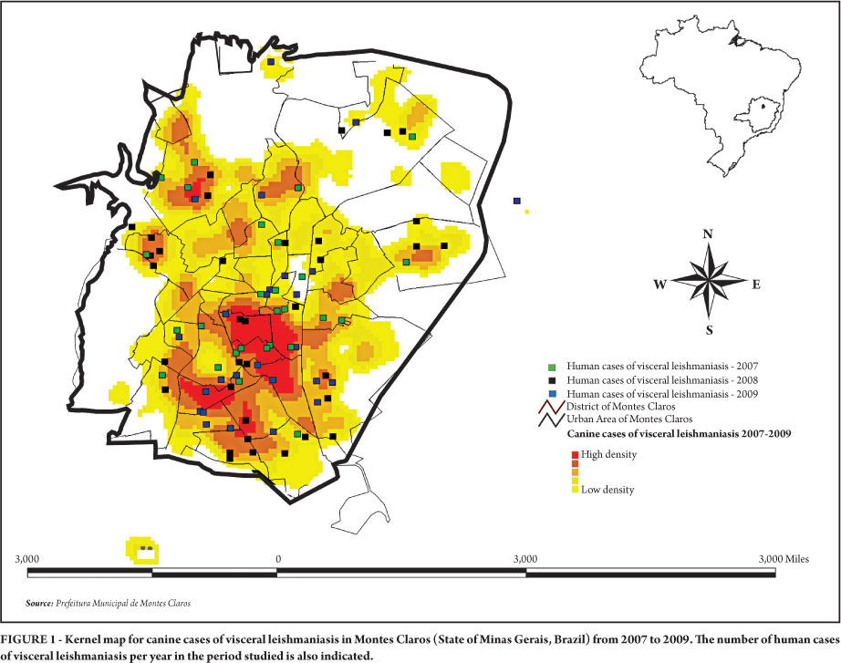
Density Estimates
Fernandes do Prado et al 2011 Rev. Soc. Bras. Med. Trop. vol.44 no.5

Slide 49
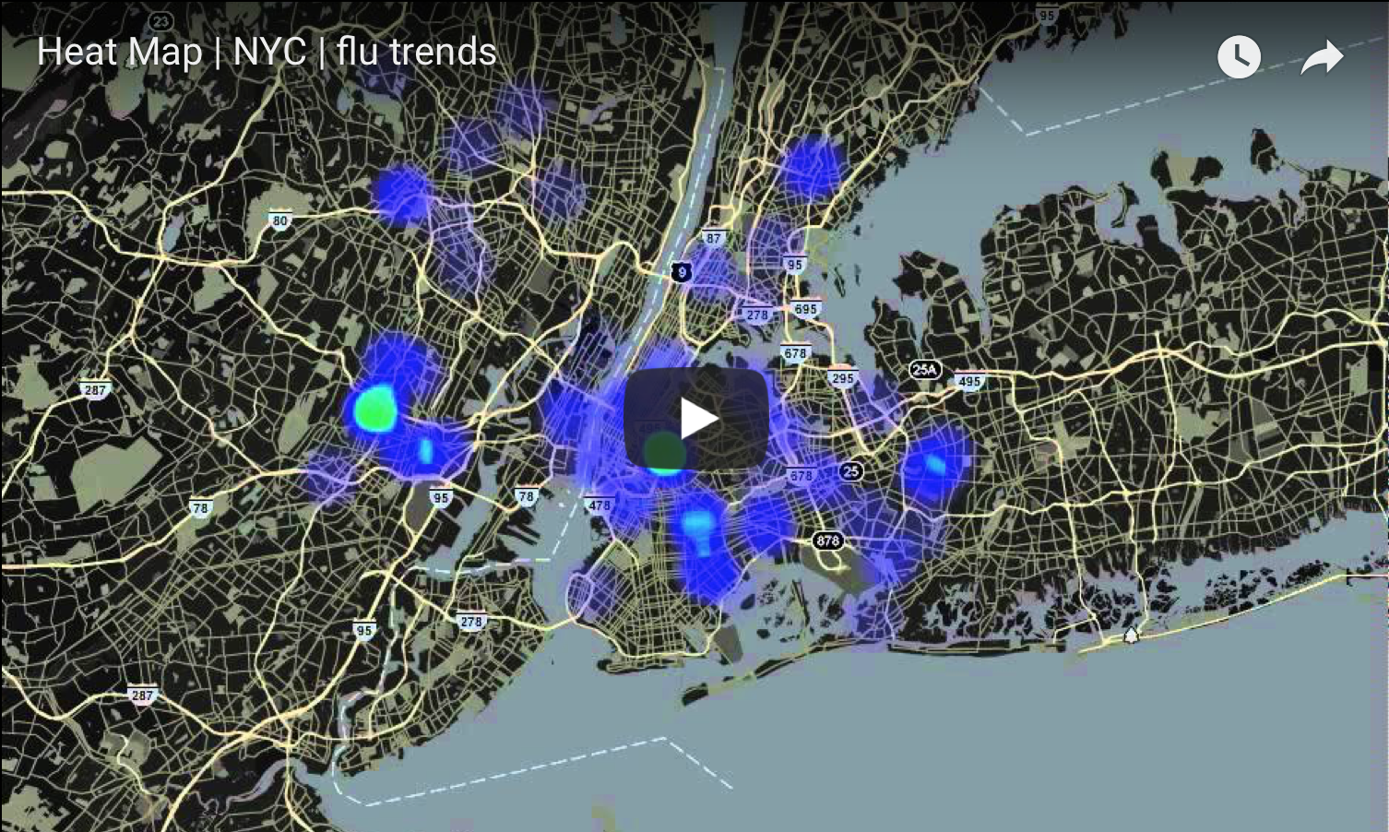
Density Estimates

Slide 50
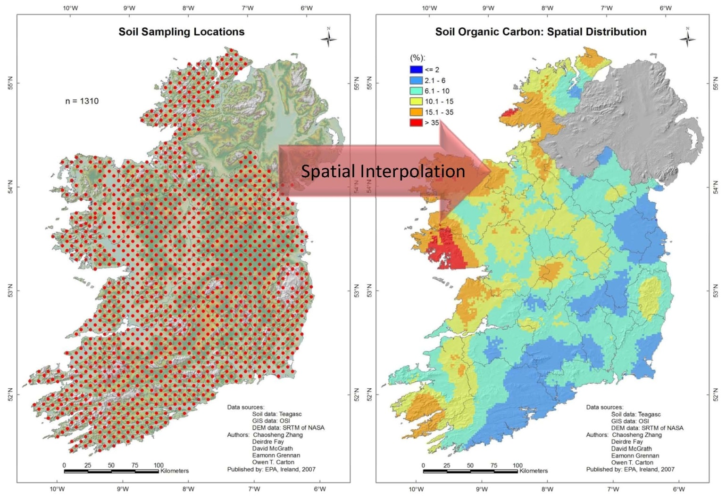
Interpolation

Slide 51
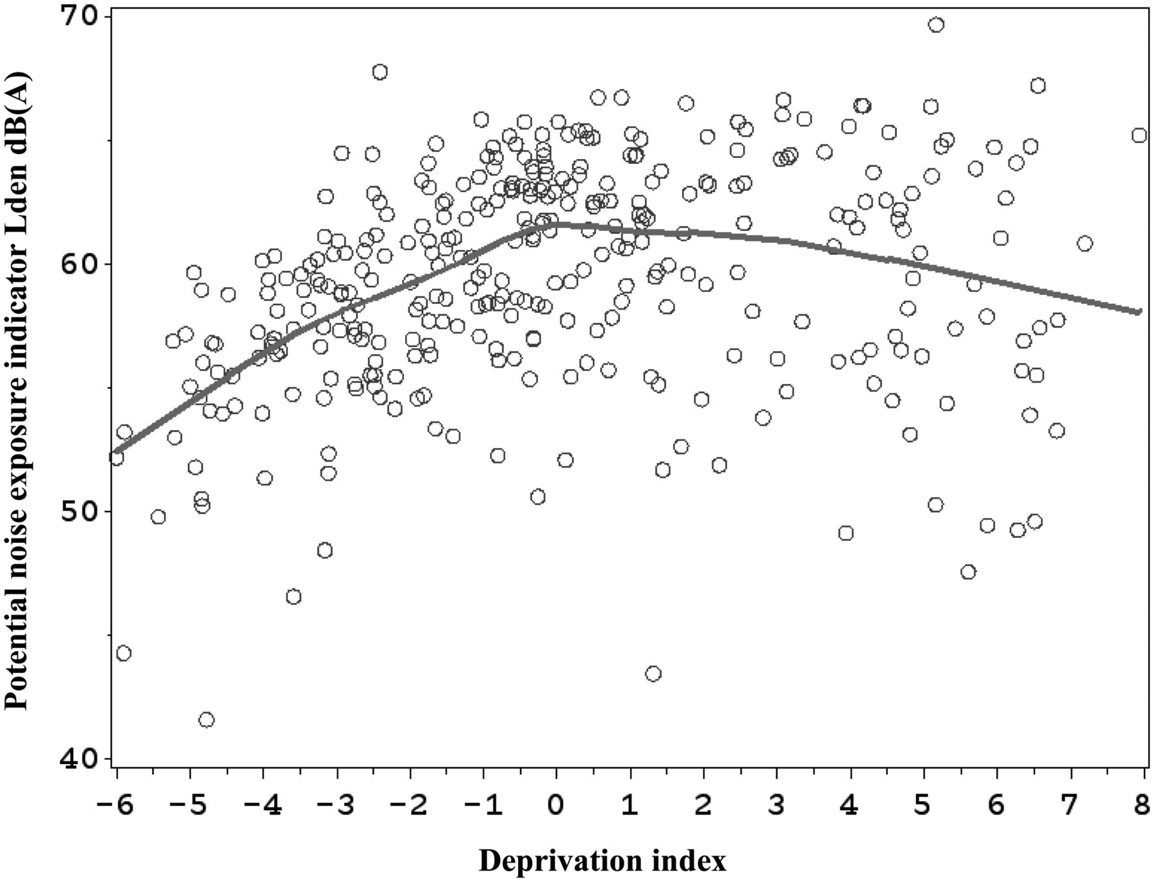
Exploring Relationships
Prevalence of infection
Exposure

Slide 52
Visualization
Exploration
Analysis

Slide 53
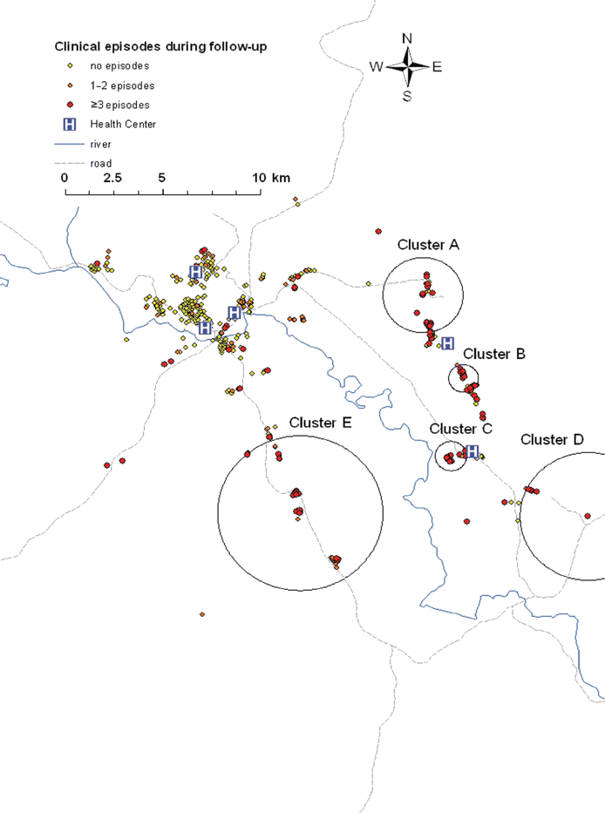
Cluster Detection
Bousema et al Journal of Infectious Diseases 201.11 (2010): 1764-1774.

Slide 54
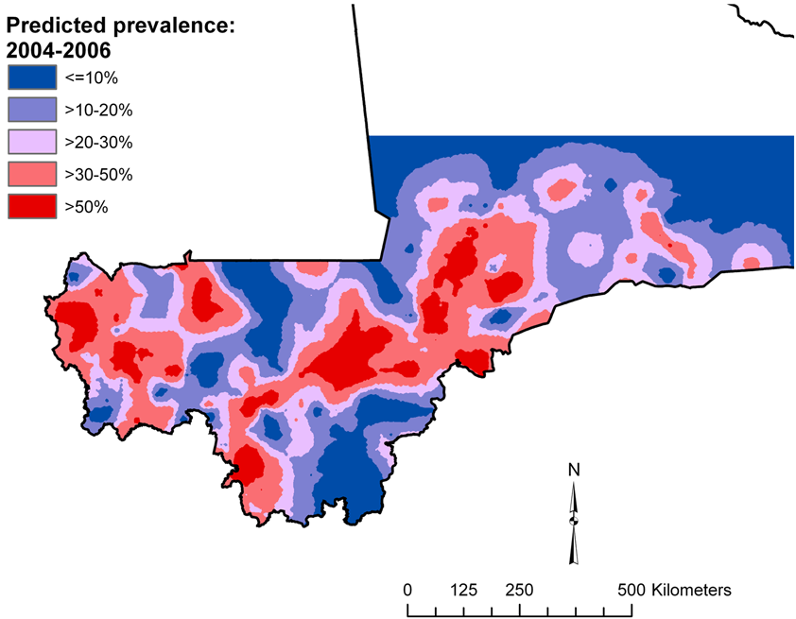
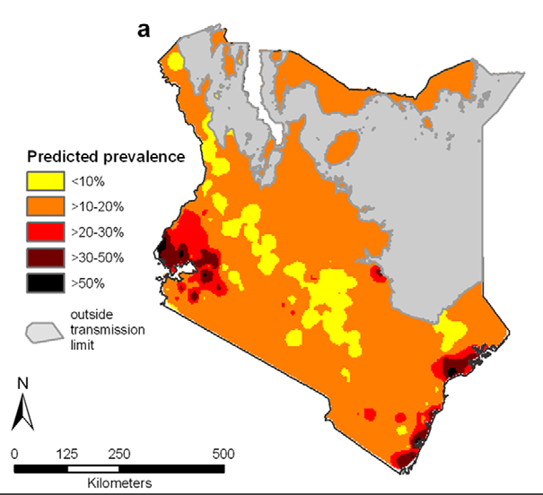
Risk Mapping
Schistosomiasis in Mali
Clements et al (2009) PLoS Negl Trop Dis 3(5): e431
Intestinal worms in Kenya
Pullan et al (2011) PLoS Negl Trop Dis 5(2): e958

Slide 55
Questions?

Slide 56
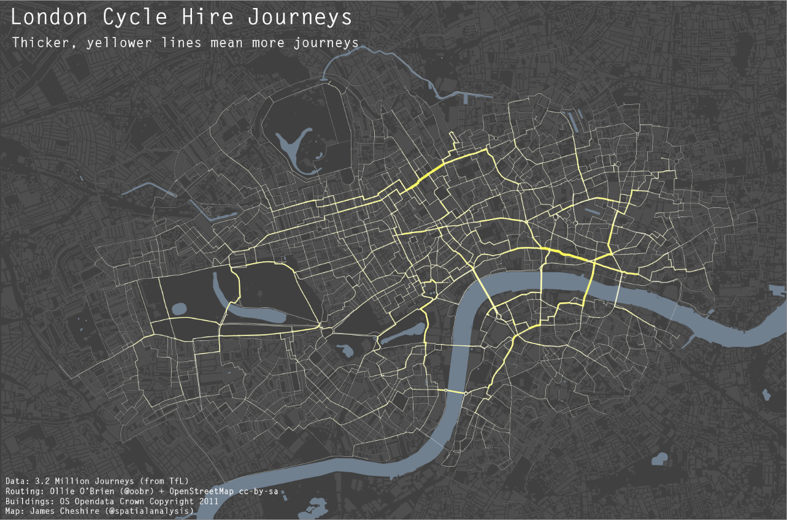
Visualizing data in R

